Slide 1
UPGRADING SPFx PROJECTS
Using @pnp/cli-microsoft365
14.JUL.2022 @DonKirkham

Slide 2














@DonKirkham Microsoft MVP, M365 Development
Enterprise Architect
https://donkirkham.com
@DonKirkham
/in/DonKirkham
DonKirkham

Slide 3

Upgrading SPFx Projects
Why
How
“I just use the latest version!”
Stable of solutions
Different versions
Need to update previous solution
Bug fix
Change functionality
Add feature
DIY (Do it yourself)
Just “NO!”
Use an upgrade tool
CLI for Microsoft 365 pnp.github.io/cli-microsoft365/
aka.ms/m365pnp

Slide 4
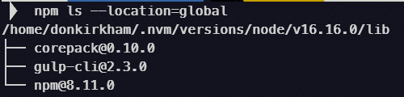
Let’s do this!
Set up environment for version of SPFx you want to upgrade to
Minimum requirement: NodeJs, gulp-cli
Install the CLI for Microsoft 365
pnp.github.io/cli-microsoft365
npm i –g @pnp/cli-microsoft365
Clone / copy / extract your project into folder
Open VS Code in the project folder
To use CodeTour option during upgrade, install CodeTour extension for VS Code
Open VS Code’s integrated terminal
m365 spfx project upgrade --output tour
m365 spfx project upgrade --output md > upgrade.md
Follow the instructions!

Slide 5





Put on your dancing shoes and let’s have some fun!
DEMO TIME!

Slide 6

Thanks for the opportunity!
Microsoft 365 Platform Community
Hope to see you soon! @DonKirkham

